Slide 1
Online Tech Shop

Slide 2
Group Member
1. Ryan Mohammad Bin Shahjahan
---- (2019-1-68-031)
2. Masudur Rabbi Rahat
---- (2019-1-60-101)

Slide 3

Project Description
We will make a website using python flask where we going to implement the online tech shop where a user can buy their favorite and necessary electronics and tech-related products with money transaction. This project is an attempt to provide the advantages of online shopping to customers of a real shop.

Slide 4
User searching. Which means user will search the product they need.
Pricing list according to their product item quantity
Adding product for admin
Delete product for admin
Register option for user and admin
Log-In option for user and admin
Database Management
Feature

Slide 5





HTML
CSS
Bootstrap
Javascript
Python (Flask)
MongoDB(Database)
Software
Usage

Slide 6
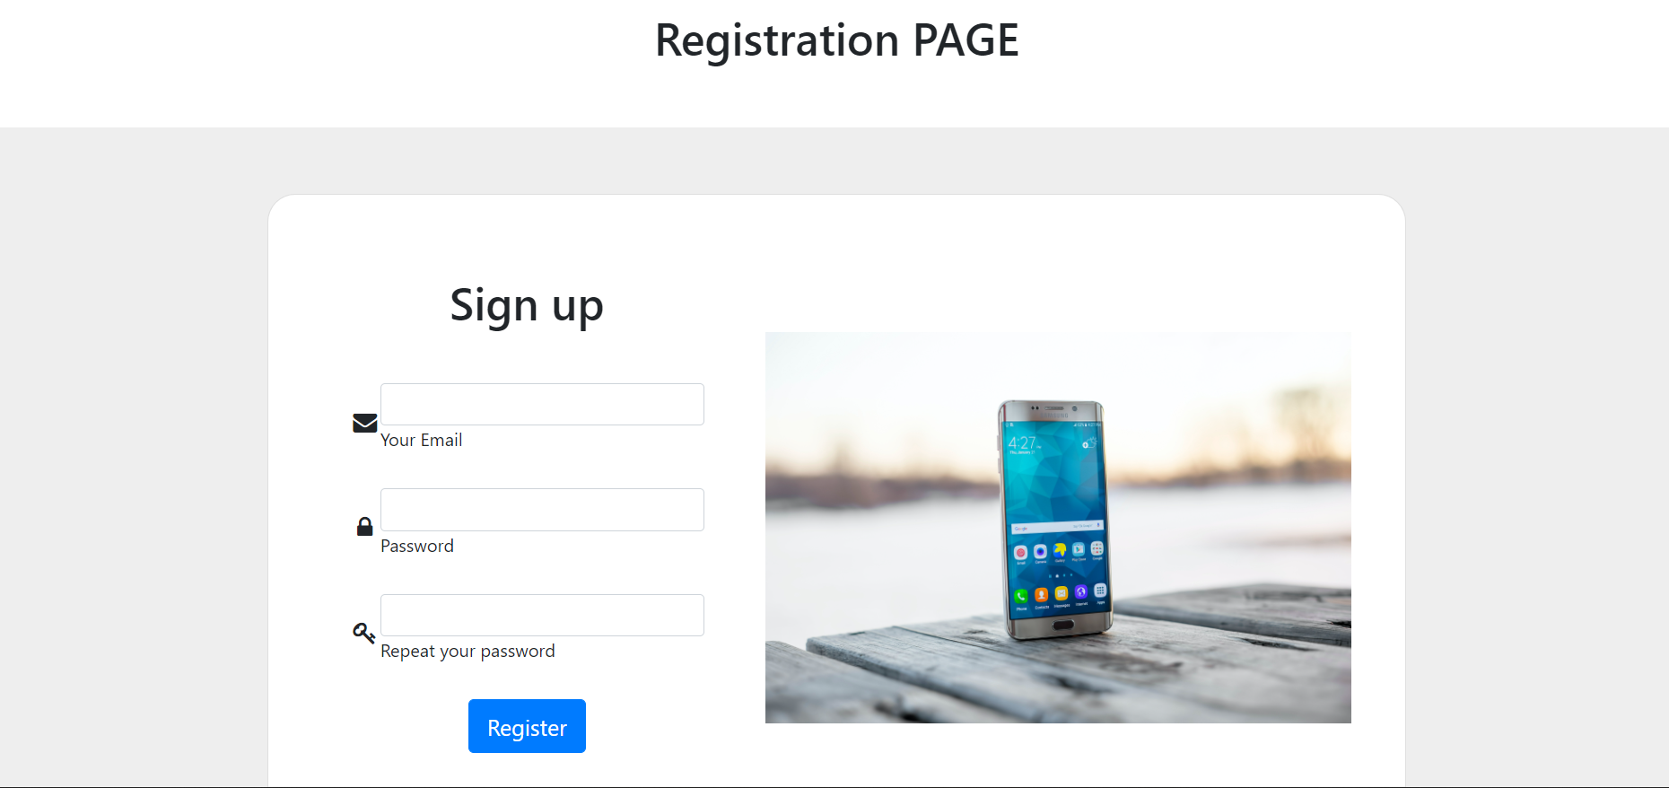
UI/UX

Slide 7
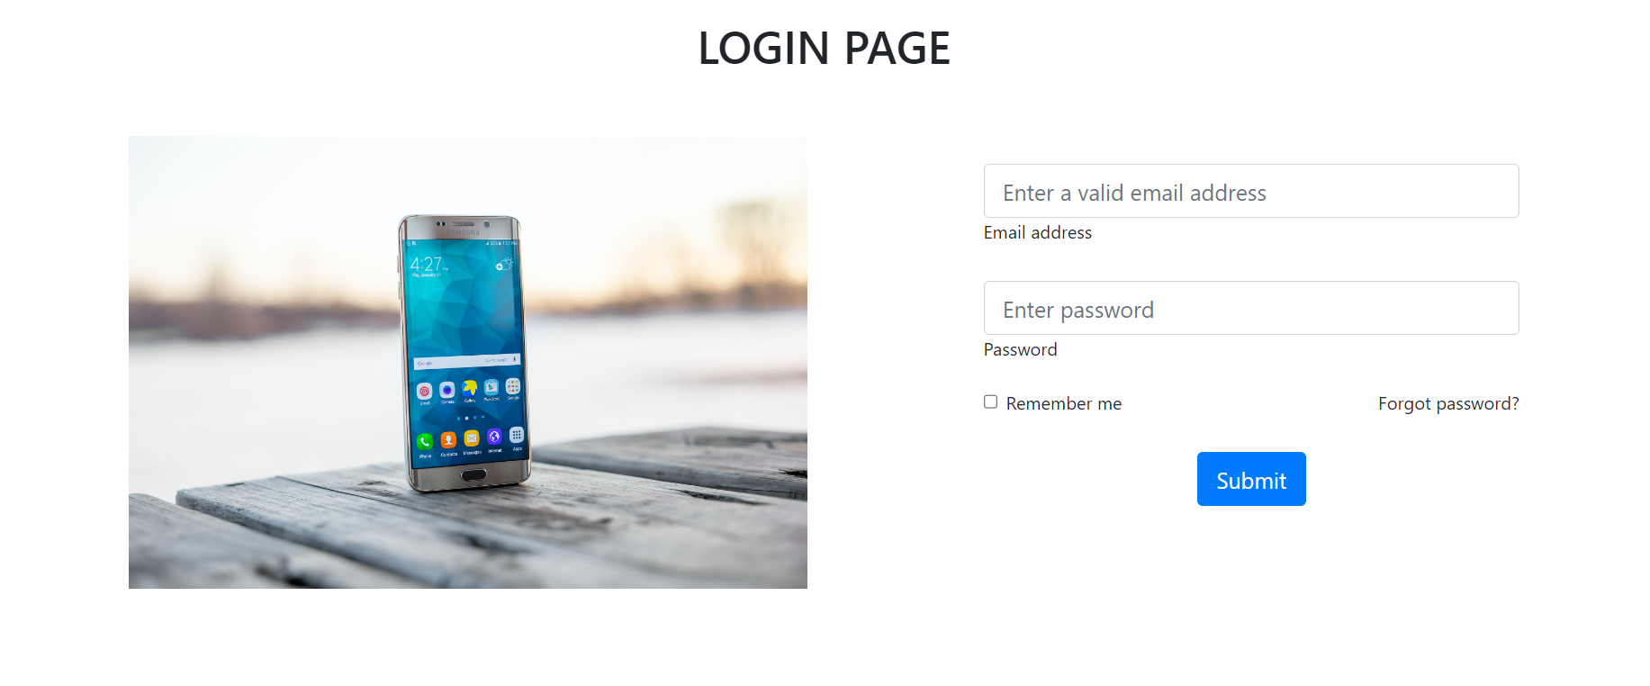
UI/UX

Slide 8
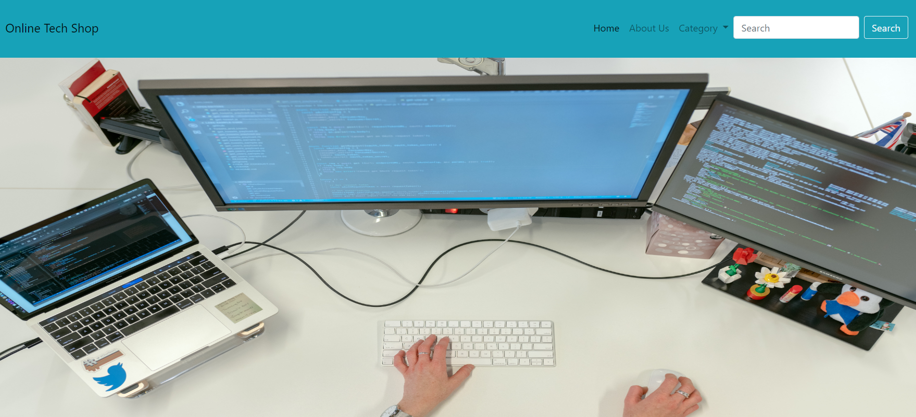
UI/UX

Slide 9
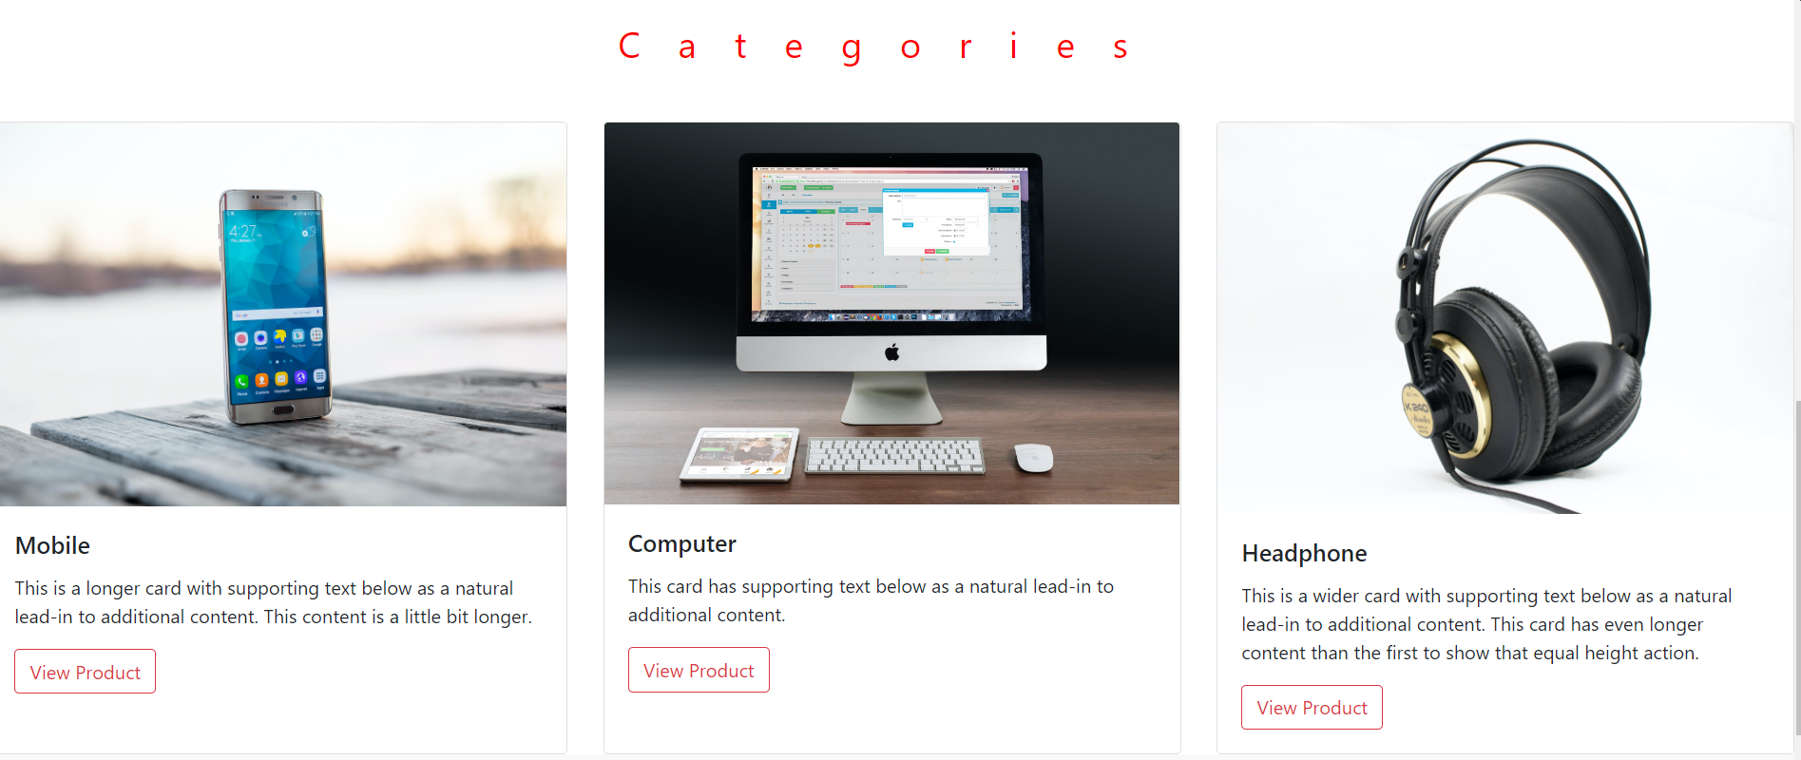
UI/UX

Slide 10
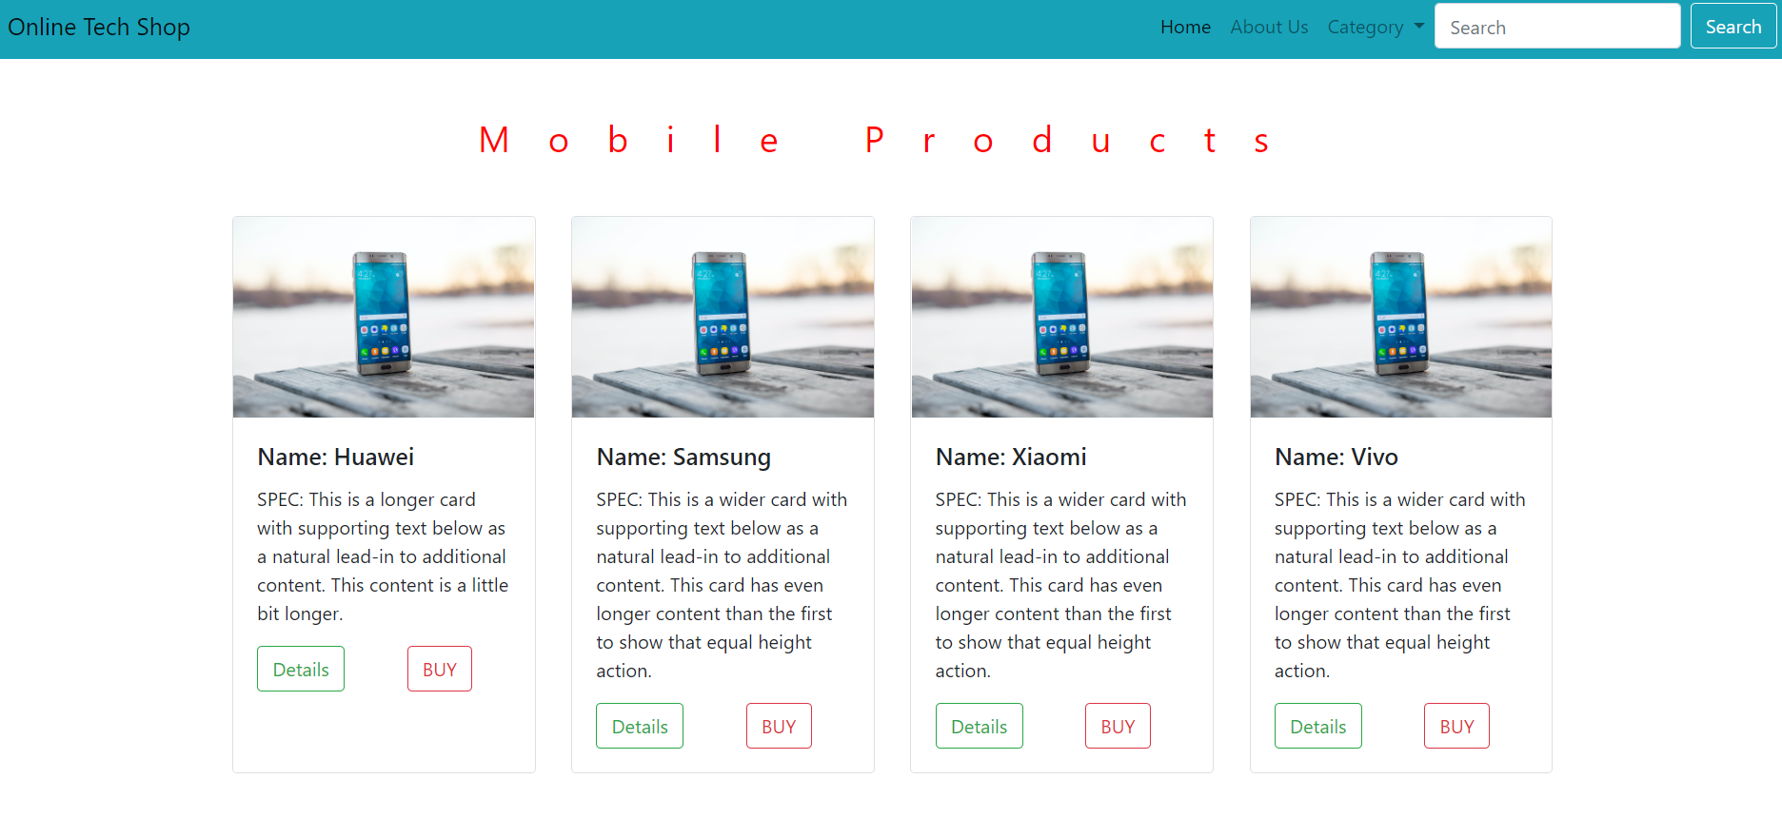
UI/UX

Slide 11
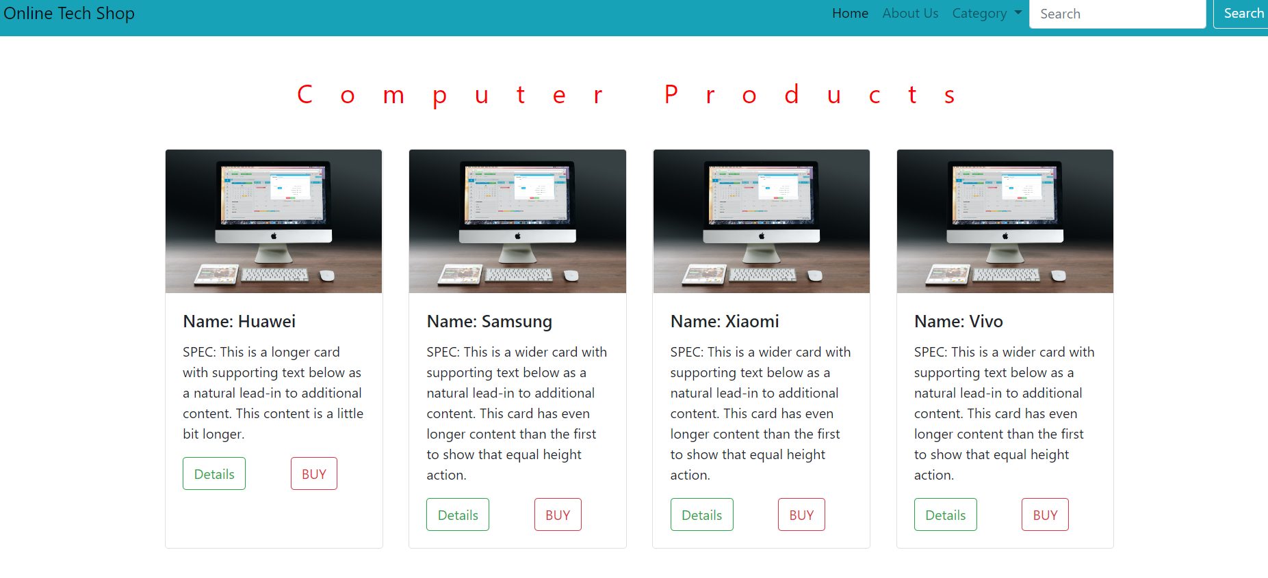
UI/UX

Slide 12
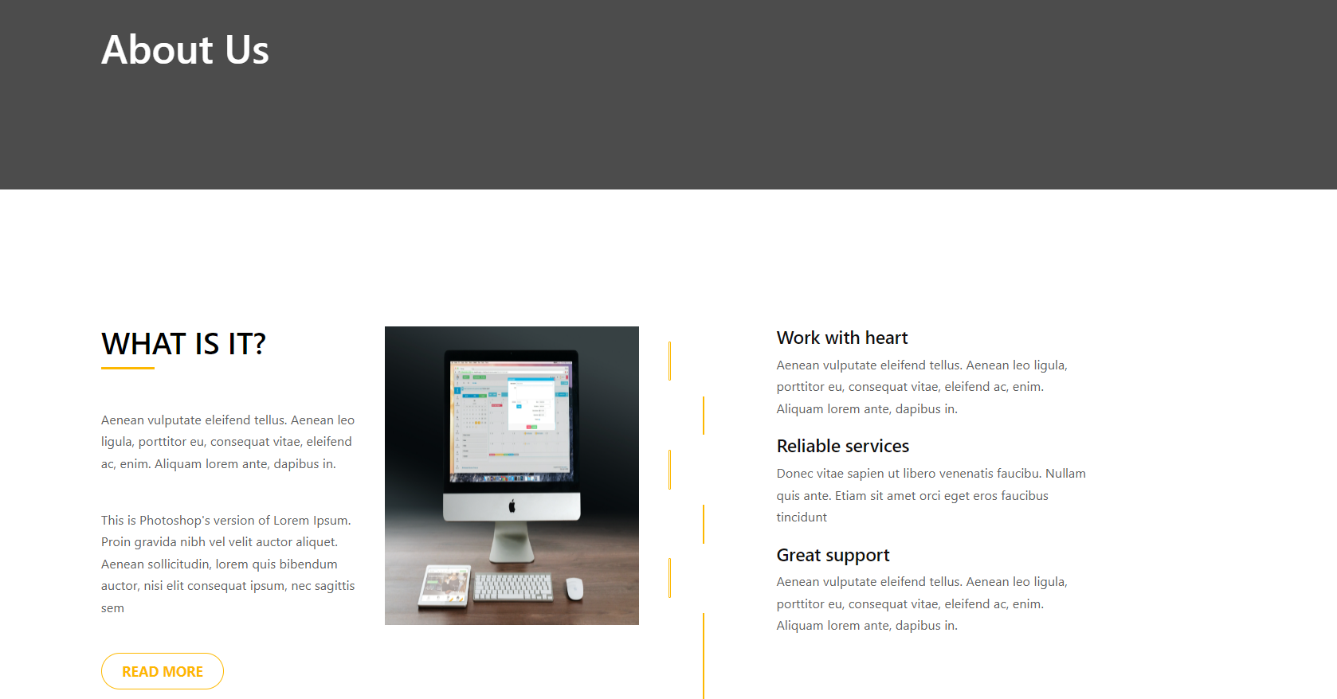
UI/UX

Slide 13
We will add more categories
We have to implement backend functions
We might add transaction
Future Works

Slide 14
THANK YOU

